Slide 1

Introducing Our Snazzy Calculator
Fun, functional, and oh-so-cool digital calculator for all your math needs!
by Tushar Gupta

Slide 2
Stylish Design
Dark Mode
Rounded Buttons
Clean Layout
Sleek dark theme for easy viewing.
Smooth, clickable buttons with hover effects.
Organized design for effortless calculations.

Slide 3

User-Friendly Features
1
Clear Display
Large input field for easy number viewing.
2
Basic Operations
Addition, subtraction, multiplication, and division at your fingertips.
3
Clear Function
Quick reset with 'C' button.

Slide 4




Tech Stack
HTML
Structured layout and content.
CSS
Stylish design and responsive layout.
JavaScript
Dynamic functionality and calculations.

Slide 5
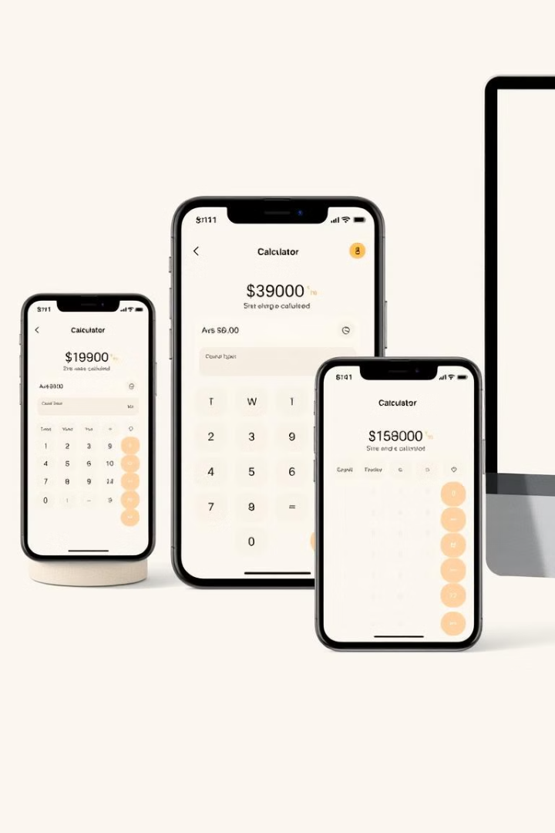



Responsive Design
Mobile-First
Optimized for smartphones and tablets.
Flexible Layout
Adapts to different screen sizes.
Touch-Friendly
Large buttons for easy tapping.

Slide 6

Accessibility Features
High Contrast
Clear Typography
Spacious Layout
Dark background with light text for readability.
Easy-to-read font choices.
Well-spaced buttons to prevent misclicks.

Slide 7

Future Enhancements
1
Memory Functions
Implement M+, M-, and MC buttons.
2
Scientific Mode
Add advanced mathematical operations.
3
History Log
Track previous calculations for easy reference.

Slide 8

Get Calculating!
Ease of Use
⭐⭐⭐⭐⭐
Design
⭐⭐⭐⭐⭐
Functionality
⭐⭐⭐⭐

